Slide 1
Chapter 3: Network Protocols and Communications
Introduction to Networks v5.1

Slide 2
Chapter Outline
3.0 Introduction
3.1 Rules of Communication
3.2 Network Protocols and Standards
3.3 Data Transfer in the Network
3.4 Summary

Slide 3
Section 3.1: Rules of Communication
Upon completion of this section, you should be able to:
Describe the types of rules that are necessary to successfully communicate.

Slide 4
Topic 3.1.1: The Rules

Slide 5
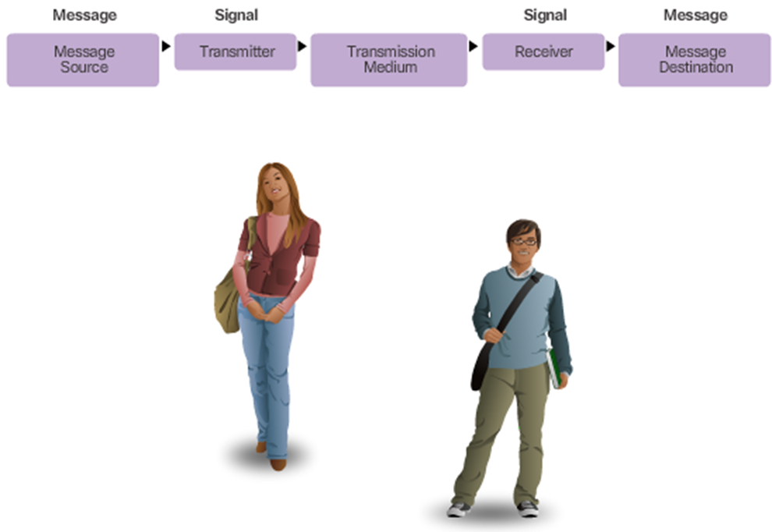
Communication Fundamentals
Human Communication
Notes:
3.1.1.1 Communication Fundamentals

Slide 6
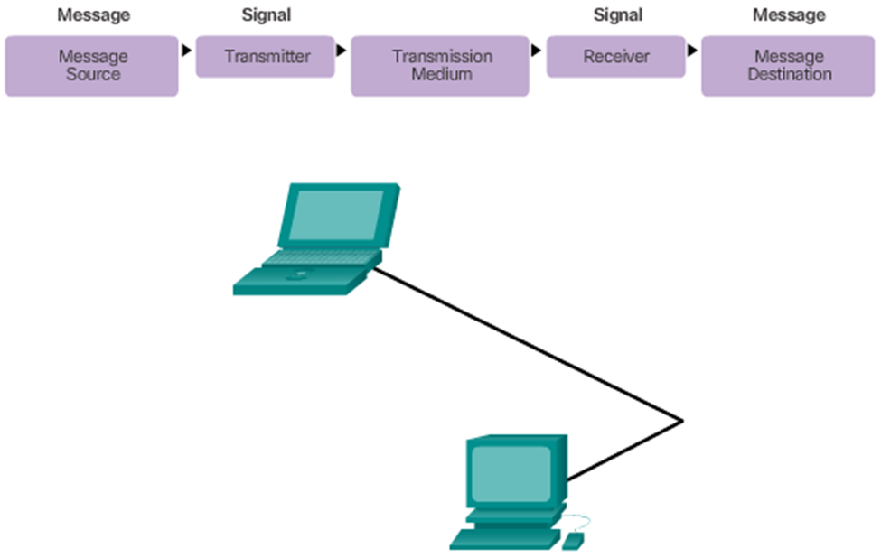
Communication Fundamentals (Cont.)
Computer Communication
Notes:
3.1.1.1 Communication Fundamentals (Cont.)

Slide 7
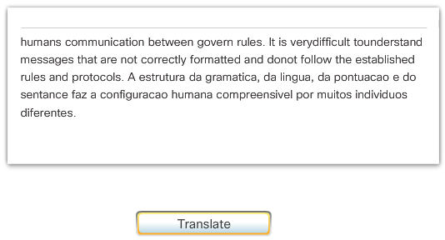
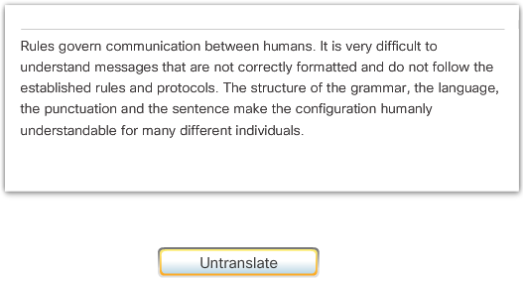
Rule Establishment
Notes:
3.1.1.2 Rule Establishment

Slide 8
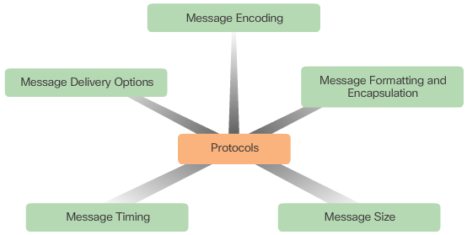
Rule Establishment (cont.)
Notes:
3.1.1.2 Rule Establishment (Cont.)

Slide 9
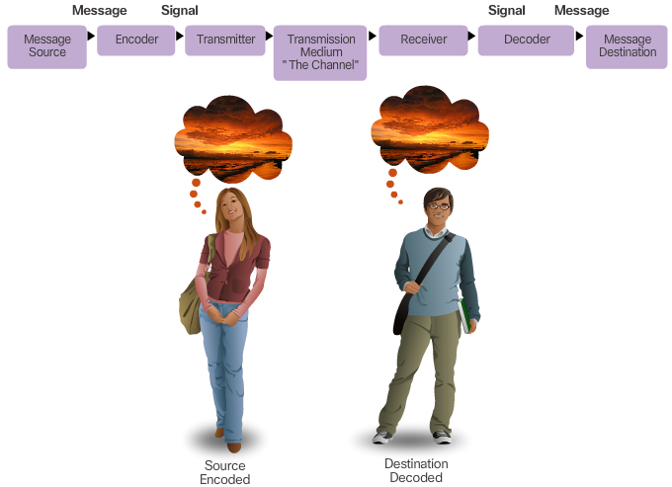
Message Encoding
Notes:
3.1.1.3 Message Encoding

Slide 10
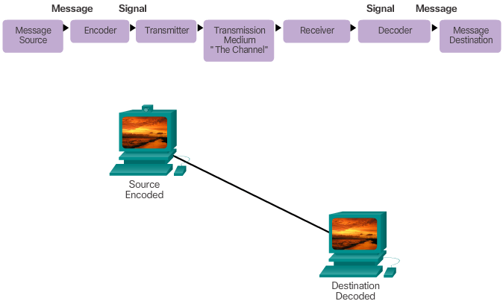
Message Encoding (cont.)
Notes:
3.1.1.3 Message Encoding (Cont.)

Slide 11
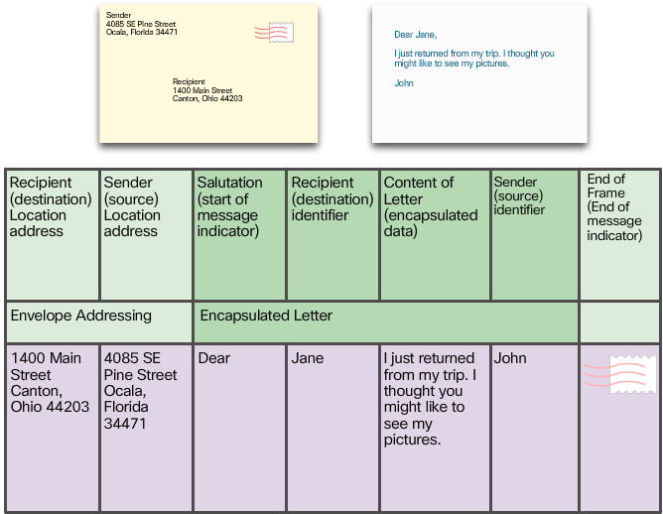
Message Formatting and Encapsulation
Notes:
3.1.1.4 Message Formatting and Encapsulation

Slide 12
Message Formatting and Encapsulation
Example: Personal letter contains the following elements:
An identifier of the recipient
A salutation or greeting
The message content
A closing phrase
An identifier of the sender
Notes:
3.1.1.4 Message Formatting and Encapsulation (Cont.)

Slide 13
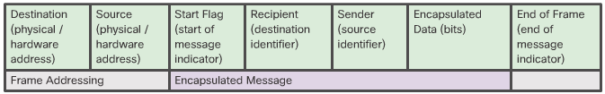
Message Formatting and Encapsulation (cont.)
Notes:
3.1.1.4 Message Formatting and Encapsulation (Cont.)

Slide 14

Message Size
Human Communication
Notes:
3.1.1.5 Message Size

Slide 15
Message Size
Computer Communication
The source host breaks a long message into individual pieces or frames that meet both the minimum and maximum size requirements.
Each frame will also have its own addressing information.
At the receiving host, the pieces are reconstructed to be processed and interpreted.
Notes:
3.1.1.5 Message Size (Cont.)

Slide 16
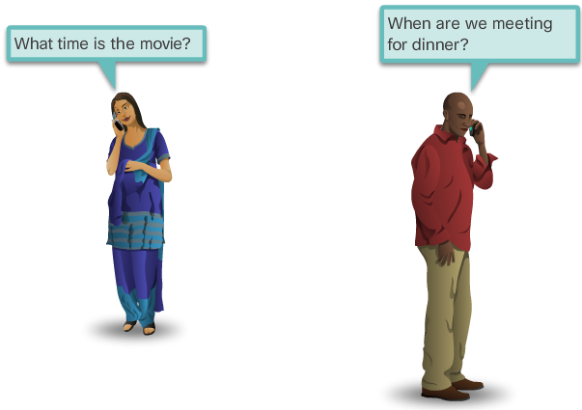
Message Timing
Rules of engagement:
Access Method
Flow Control
Response Timeout
Notes:
3.1.1.6 Message Timing

Slide 17
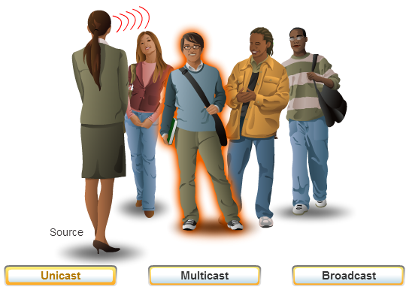
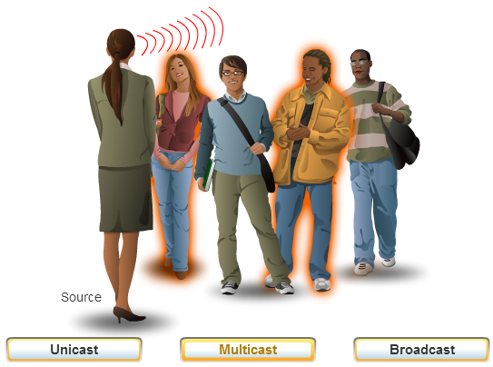
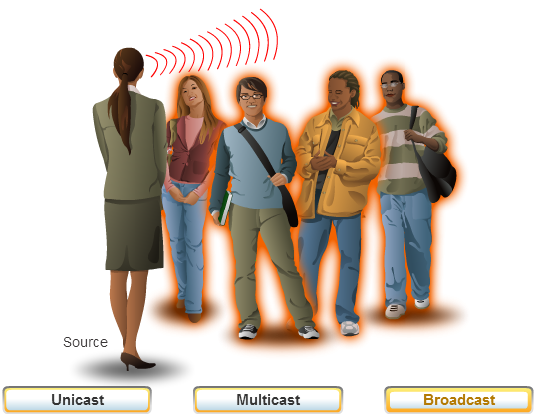
Message Delivery Options
Notes:
3.1.1.7 Message Delivery Options

Slide 18
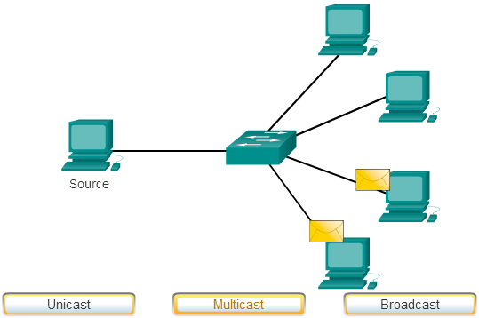
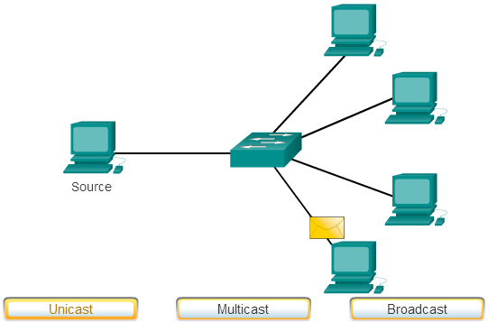
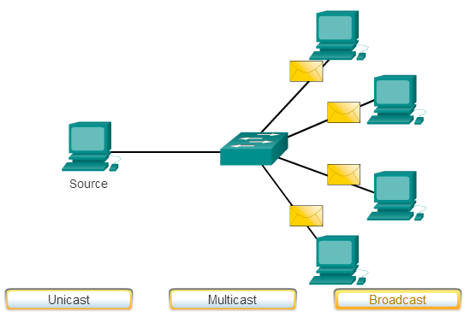
Message Delivery Options (cont.)
Notes:
3.1.1.7 Message Delivery Options (Cont.)

Slide 19
Section 3.2: Network Protocols and Standards
Upon completion of this section, you should be able to:
Explain why protocols are necessary in communication.
Explain the purpose of adhering to a protocol suite.
Explain the role of standards organizations in establishing protocols for network interoperability.
Explain how the TCP/IP model and the OSI model are used to facilitate standardization in the communication process.

Slide 20
Topic 3.2.1: Protocols

Slide 21
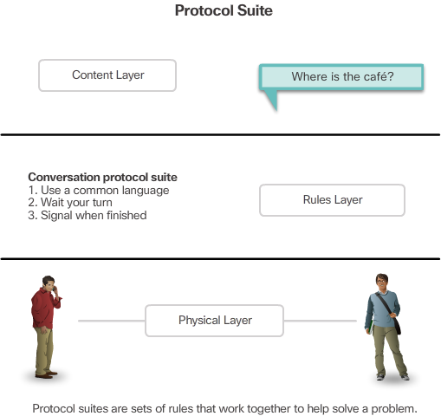
Rules that Govern Communications
Notes:
3.2.1.1 Rules that Govern Communications

Slide 22
Network Protocols
The role of protocols
How the message is formatted or structured
The process by which networking devices share information about pathways with other networks
How and when error and system messages are passed between devices
The setup and termination of data transfer sessions
Notes:
3.2.1.2 Network Protocols

Slide 23
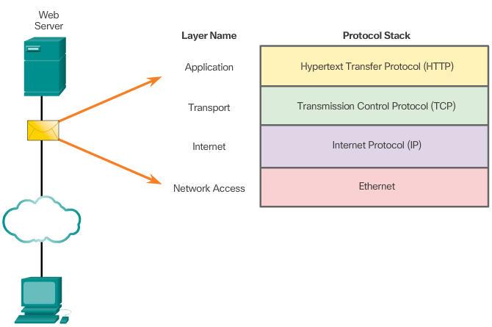
Protocol Interaction
Interaction of protocols in communication between a web server and web client.
Notes:
3.2.1.3 Protocol Interaction

Slide 24
Topic 3.2.2: Protocol Suites

Slide 25
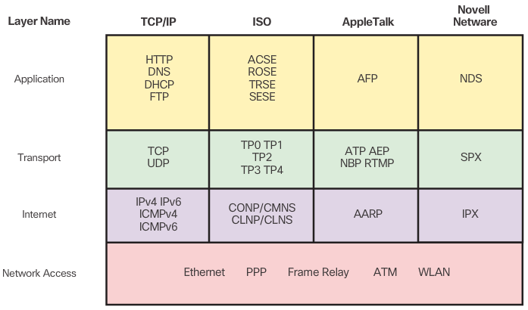
Protocol Suites and Industry Standards
Notes:
3.2.2.1 Protocol Suites and Industry Standards

Slide 26
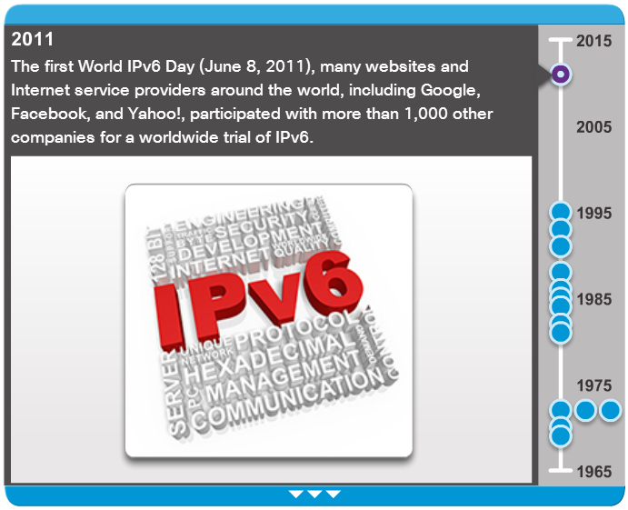
Development of TCP/IP
Notes:
3.2.2.2 Development of TCP/IP

Slide 27
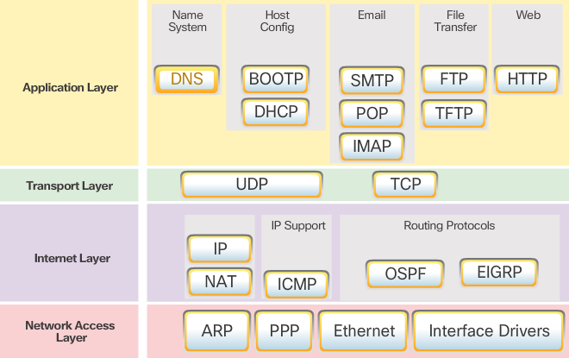
TCP/IP Protocol Suite
Notes:
3.2.2.3 TCP/IP Protocol Suite

Slide 28
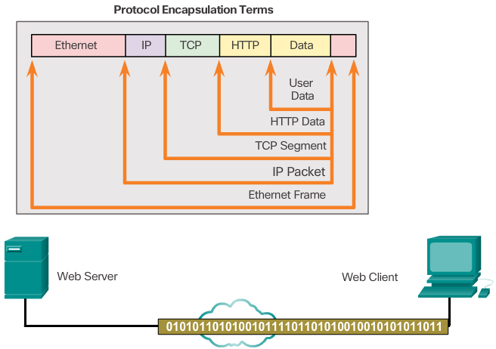
TCP/IP Communication Process
Protocol Operation - Sending a Message
Notes:
3.2.2.4 TCP/IP Communication Process

Slide 29
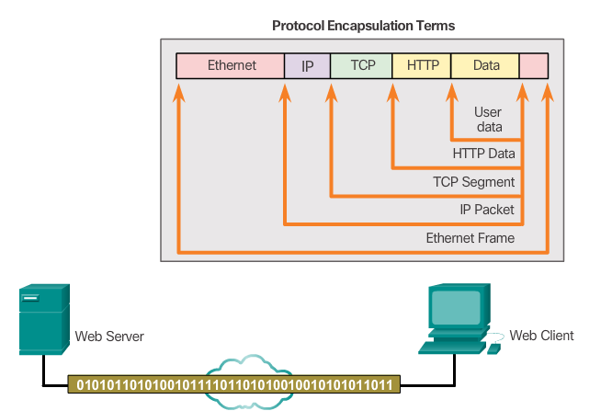
TCP/IP Communication Process
Protocol Operation – Receiving a Message
Notes:
3.2.2.4 TCP/IP Communication Process (Cont.)
3.2.2.5 Activity – Mapping the Protocols of the TCP/IP Site

Slide 30
Topic 3.2.3: Standard Organizations

Slide 31

Open Standards
Notes:
3.2.3.1 Open Standards

Slide 32
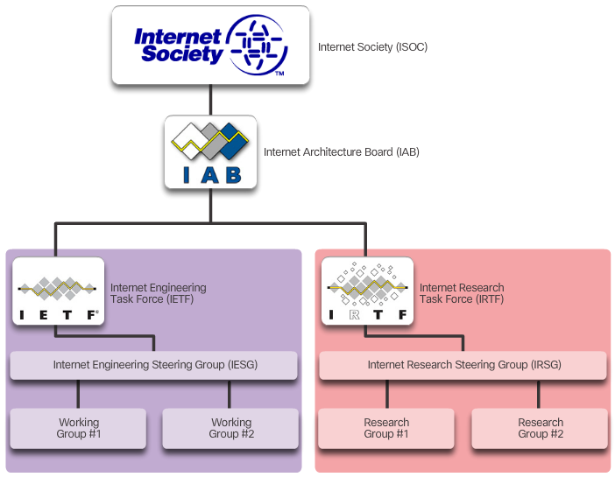
Internet Standards
ISOC, IAM, IETF, and IRTF
Notes:
3.2.3.2 Internet Standards

Slide 33
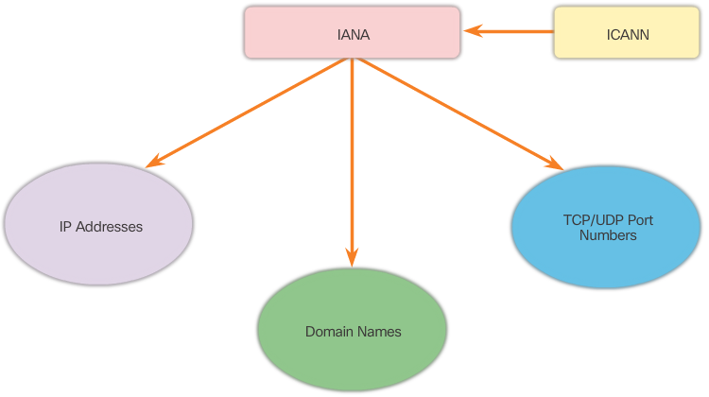
Internet Standards (cont.)
IANA and ICANN
Notes:
3.2.3.2 Internet Standards (Cont.)

Slide 34
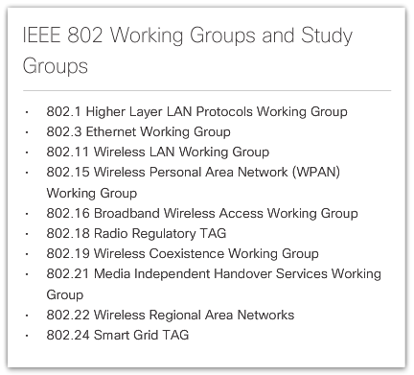
Electronics and Communications Standard Organizations
Institute of Electrical and Electronics Engineers (IEEE)
Notes:
3.2.3.3 Electronics and Communications Standard Organizations

Slide 35
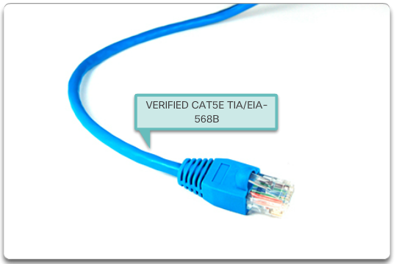
Electronics and Communications Standard Organizations (cont.)
EIA/TIA Standards
Notes:
3.2.3.3 Electronics and Communications Standard Organizations (Cont.)
3.2.3.4 Lab- Researching Networking Standards

Slide 36
Topic 3.2.4: Reference Models

Slide 37
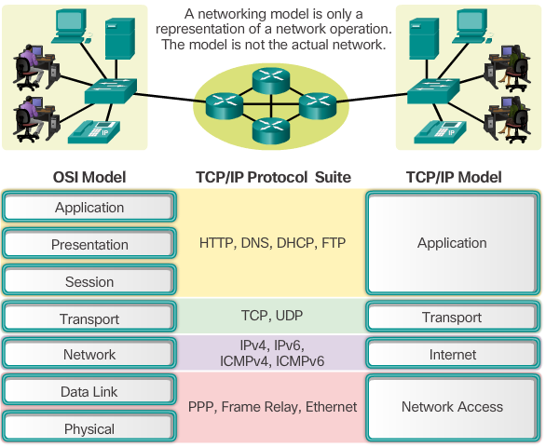
The Benefits of Using a Layered Model
Notes:
3.2.4.1 The Benefits of Using a Layered Model

Slide 38
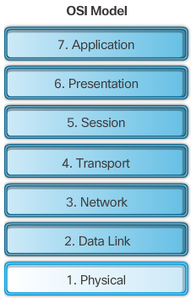
The OSI Reference Model
Notes:
3.2.4.2 The OSI Reference Model

Slide 39
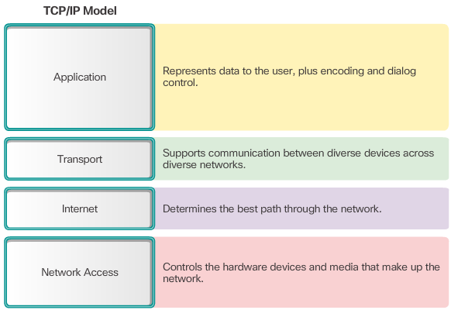
The TCP/IP Protocol Model
Notes:
3.2.4.3 The TCP/IP Protocol Model

Slide 40
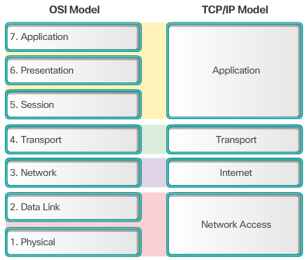
OSI Model and TCP/IP Model Comparison
Notes:
3.2.4.4 OSI Model and TCP/IP Model Comparison
3.2.4.5 Activity – Identify Layers and Functions
3.2.4.6 Packet Tracer – Investigating the TCP/IP and OSI Models in Action

Slide 41
Section 3.3: Data Transfer in the Network
Upon completion of this section, you should be able to:
Explain how data encapsulation allows data to be transported across the network.
Explain how local hosts access local resources on a network.

Slide 42
Topic 3.3.1: Data Encapsulation

Slide 43
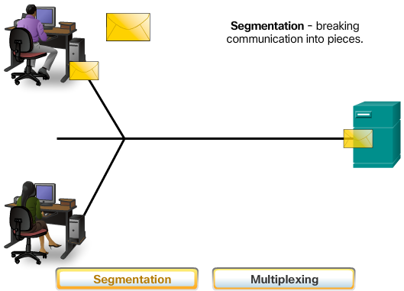
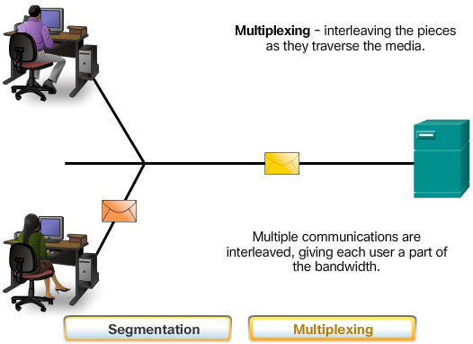
Message Segmentation
Communicating the Message
Notes:
3.3.1.1 Message Segmentation

Slide 44
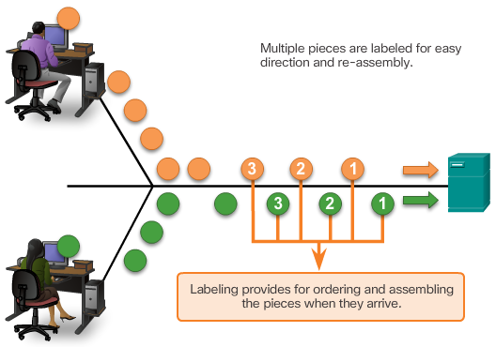
Message Segmentation (cont.)
Communicating the Message
Notes:
3.3.1.1 Message Segmentation (Cont.)

Slide 45
Communicating the Message
Segmenting Messages:
Allows many different conversations to be interleaved
Increases the efficiency of network communications
Adds complexity
Notes:
3.3.1.1 Communicating the Message

Slide 46
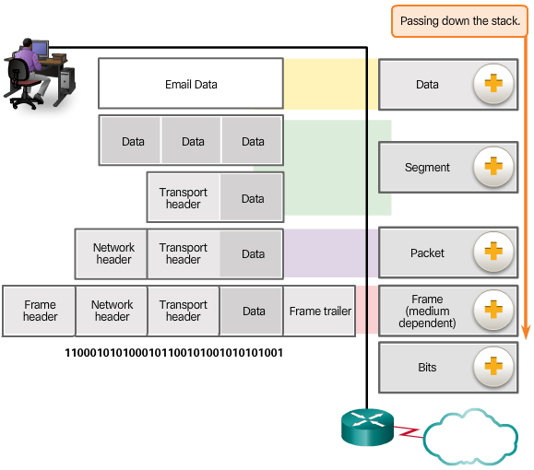
Protocol Data Units
Encapsulation
Data
Segment
Packet
Frame
Bits
Notes:
3.3.1.2 Protocol Data Units

Slide 47
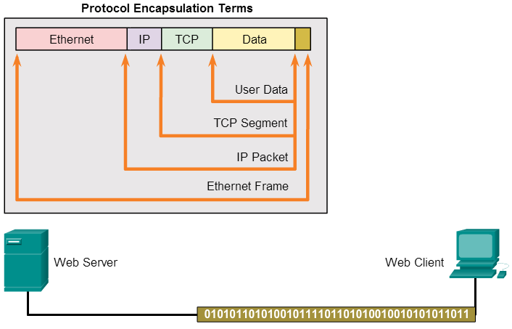
Encapsulation Example
Notes:
3.3.1.3 Encapsulation Example

Slide 48
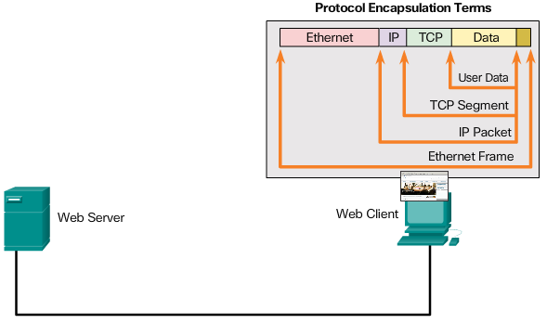
De-Encapsulation
Notes:
3.3.1.4 De-Encapsulation
3.3.1.5 Activity – Identify the PDU Layer

Slide 49
Topic 3.3.2: Data Access

Slide 50
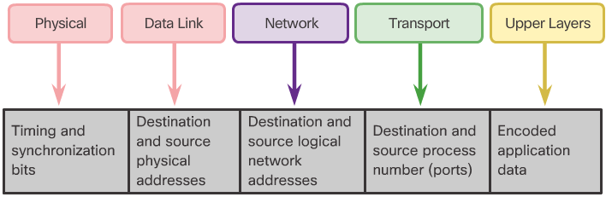
Network Addresses
Network Addresses and Data Link Addresses
Notes:
3.3.2.1 Network Addresses

Slide 51
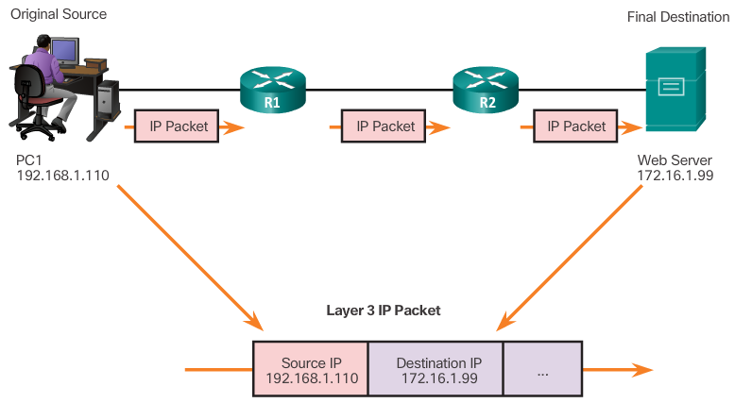
Network Addresses (cont.)
Layer 3 Network Addresses
Notes:
3.3.2.1 Network Addresses (Cont.)

Slide 52
Data Link Addresses
Network Address
Source IP address
Destination IP address
Responsible for delivering the IP packet from the original source to the final destination, either on the same network or to a remote network.
Data Link Address
Source data link address
Destination data link address
Responsible for delivering the data link frame from one network interface card (NIC) to another NIC on the same network
Notes:
3.3.2.2 Data Link Addresses

Slide 53
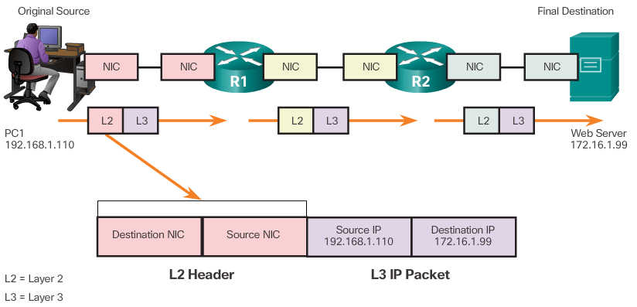
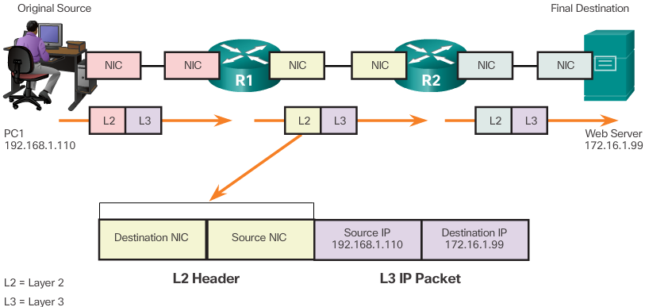
Data Link Address (cont.)
Layer 2 Data Link Addresses
Notes:
3.3.2.2 Data Link Address (Cont.)

Slide 54
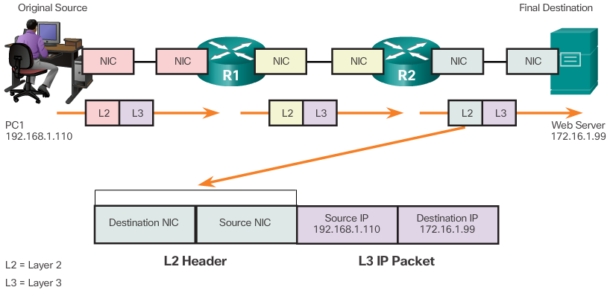
Data Link Address (cont.)
Layer 2 Data Link Addresses
Notes:
3.3.2.2 Data Link Address (Cont.)

Slide 55
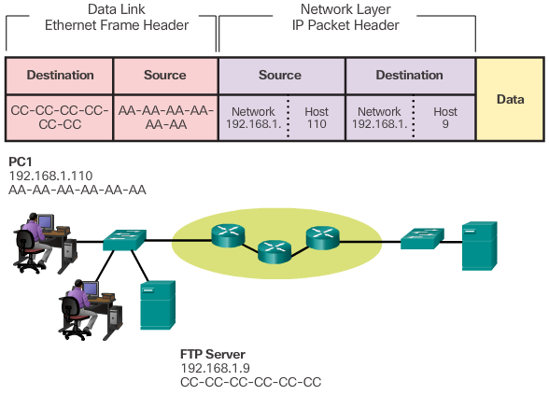
Devices on the Same Network
Notes:
3.3.2.3 Devices on the Same Network

Slide 56
Devices on the Same Network (cont.)
Role of the Network Layer Addresses
Network portion of the IP Address – The left-most part of the address that indicates which network the IP address is a member.
Host portion – The remaining part of the address that identifies a specific device on the network.
Source IP address – The IP address of the sending device
Destination IP address – The IP address of the receiving device
Role of the Data Link Layer Addresses
Source MAC address – This is the data link address, or the Ethernet MAC address, of the sending device.
Destination MAC address – When the receiving device is on the same network as the sending device, this is the data link address of the receiving device.
Notes:
3.3.2.3 Devices on the Same Network (cont.)

Slide 57
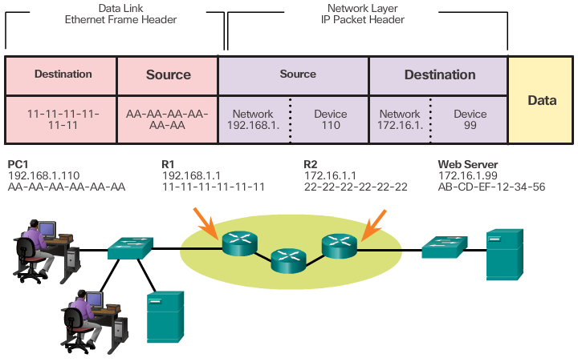
Devices on a Remote Network
Notes:
3.3.2.4 Devices on a Remote Network

Slide 58
Devices on a Remote Network (cont.)
Role of the Network Layer Addresses
The source and destination IP addresses will represent hosts on different networks indicated by the different network portions of the source and destination addresses.
Role of the Data Link Layer Addresses
Destination MAC address - When the receiving device is on a different network from the sending device, the sending device uses the Ethernet MAC address of the default gateway or router.
Notes:
3.3.2.4 Devices on a Remote Network (cont.)

Slide 59
Section 3.4: Summary
Chapter Objectives:
Explain how rules are used to facilitate communication.
Explain the role of protocols and standards organizations in facilitating interoperability in network communications.
Explain how devices on a LAN access resources in a small to medium-sized business network.
Notes:
3.4.1.1 Lab - Installing Wireshark
3.4.1.2 Lab - Using Wireshark to View Network Traffic
3.4.1.3 Class Activity – Guaranteed to Work!
3.4.1.4 Chapter 3: Network Protocols and Communications

